Slide 1
Temperature & Humidity Testing Device Based on the DHT-11 micro-controller
Sensor and Sensing Technologies Course

Slide 2
Introduction
The project is about making a temperature and humidity testing device that will display the results on a User Interface created using C# on Microsoft Visual Studio.
This project will show air temperature in C and F, and % Humidity on a User Interface installed on a computer.

Slide 3
Items used
Breadboard x1
DHT-11 Temperature and Humidity Sensor
Connector cables
10k resistor x1
Light Emitting Diode x1
Arduino
Computer with Arduino and Visual Studio software installed

Slide 4
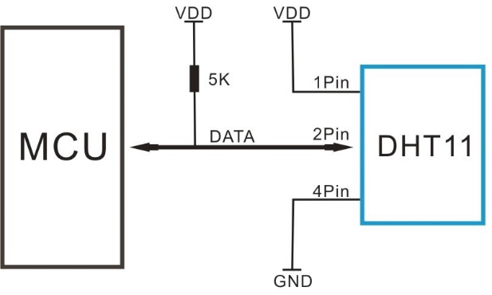
Connections

Slide 5
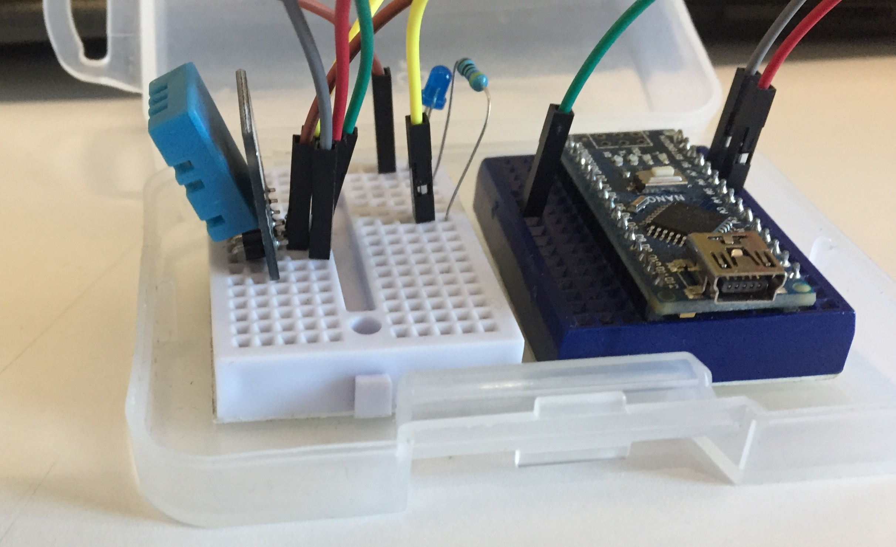
Pictures

Slide 6
